Slide 1
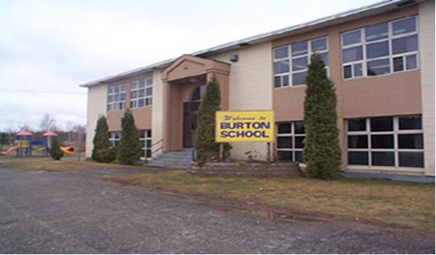
Sustainability Study of Burton Elementary School

Slide 2
Public Meeting #1 Agenda
Introductions
Review of Provincial Policy 409 Multi–Year School Infrastructure Planning
Presentation of Facts – Burton Elementary School
Question and Answer
What’s Next?
Online Resources and Feedback
Next Meetings

Slide 3
Provincial Policy 409: Multi-year School Infrastructure Planning
Outlines a number of responsibilities to do with facilities in our system
Sections 6.4, 6.5 and 6.6 are relevant for Sustainability Studies
Three Public Meetings
Meeting 1 – Presentation of Facts from District regarding School (Policy 409, 6.4.4 )
Meeting 2 - Presentation from Stakeholders regarding their thoughts on the sustainability of the school and relevant factors
Meeting 3 – Final Review of Information by District Education Council (DEC) and subsequent motion on next steps
Three Possible Outcomes
Status Quo
Recommendation to Minister to repair the school
Recommendation to Minister for closure, moving the students elsewhere
Not Designed as an “Us-Against-Them” process; public meetings are not designed to facilitate debate between two parties

Slide 4
Enrolment Burton Elementary School

Slide 5
Enrolment By Grade Level: Burton Elementary School
 | 2008 | 2009 | 2010 | 2011 | 2012 | 2013 | 2014 | 2015 Projected
K | 22 | 19 | 14 | 12 | 22 | 19 | 21 | 11
1 | 12 | 20 | 18 | 14 | 12 | 18 | 20 | 20
2 | 15 | 17 | 20 | 17 | 19 | 11 | 18 | 18
Total | 49 | 56 | 52 | 43 | 53 | 48 | 59 | 49
Notes:
Trend indicates a decrease in students when looking at specific cohorts , with exception to the 2010 cohort which saw an increase of 5 by grade 2.

Slide 6
Projected Enrolment Burton Elementary School

Slide 7
Functional Capacity
Functional Capacity Data | Student Enrollment | Number of Classrooms | Classrooms in Use | School Capacity | Capacity Rating
Based on 21 Students per class | 59 | 4 | 3 | 84 | 70.2%

Slide 8
Quality of Education Programs and Services
Educational Staff
The provincial staffing formula calls for:
Student Teacher Ratio Burton Elementary School
Full Time Equivalent (FTE) 2015-16 | Burton Elementary School
Classroom Teachers | 3.3 FTE
Administration | 0.4 FTE
Guidance | 0.0 FTE
Resource | 0.3 FTE
Total | 4.0 FTE
Year | Total Number Student : Ratio | Student : Teacher
2014-15 | 59 : 5.4 | 10.92 : 1
2015-16 | 48 : 4.0 | 12.00 : 1
Notes:
Remember this is 2015-16 staffing.

Slide 9
Support Staff Information
Full Time Equivalent (FTE) 2015-16 | Burton Elementary School
Educational Assistants | 2. 0 FTE
Administrative Assistant | 36.25 hours per week (1.0 FTE)
School Library Worker 1 | 2.5 hours per week (0.068 FTE)
Custodian | Custodial Service is contracted
Notes:
Remember this is 2015-16 staffing.

Slide 10
Burton Elementary School Student : Teacher Ratio 2014-15
School | Year | Total Number Student: Teacher | Student: Teacher
Burton Elementary | 2014 - 2015 | 59 : 5.4 | 10.92 : 1
Millville Elementary | 2014 – 2015 | 40 : 4.20 | 9.52 : 1
Chipman Elementary | 2014 – 2015 | 104 : 8.00 | 13.00 : 1
Lincoln Elementary | 2014 - 2015 | 171 : 13:5 | 12.67 : 1

Slide 11
Class Size Comparisons 2014-2015
 | Minimum Class Size | Maximum Class Size | Average Class Size | Number of Classes 2014-15 | Number of Classes 2015-16
Burton Elementary School | 18 | 21* | 20 | 3* | Minimum class size - 11 Maximum class size - 19 Average class size - 16 3
Millville Elementary School | 13 | 14 | 13 | 3 | 3
Lincoln Elementary School | 13 | 21 | 17 | 10 | 10
Chipman Elementary School | 14 | 21 | 17 | 6 | 7
Notes:
* Student moved in after Sept. 30 cutoff for enrolment

Slide 12
Maximum class sizes
Grade Level | Maximum Number of Students
K-2 | 21
3 | 26
K-3 Combined Classes | 16
Grades 4-6 | 28
Grades 3 -5 Combined Classes | 23
Grades 7 to 12 | 29
Grades 5 to 12 Combined Classes | 24

Slide 13
Core Curriculum
 | Early French Immersion | Late French Immersion | Gymnasium | Music/Fine Arts Specialists | Educational Support Services | EST-Literacy | EST-Math | EST-Technology
Burton Elementary School | NA | NA | No | No | Yes | Yes | Yes | Request Support
 | EST-French ImmersionI | EST Science | Science Labs | Computer Lab | Computer Aided Drafted Lab (CAD) | Middle Level Technology | Broad Based Technology | Skills Trade Area | Distance Learning
Burton Elementary School | No | Yes | No | No | NA | NA | NA | NA | NA

Slide 14
Quality of Education Programs and Service
Grade 2 students from Burton Elementary School enter Hubbard Avenue School for Prime or French Immersion Programs beginning in grade 3.

Slide 15
Impact on Other Schools
Beyond a decision of status quo or a recommendation to fix/upgrade the school as it stands now, the following scenario rises to the surface as a possible consideration:
Movement of students from Burton Elementary School to Assiniboine Avenue Elementary School for Grades K-2.
It is noted that parent leadership from Burton Elementary School has expressed its’ desire for the District Education Council to consider placing Burton Elementary School on the priority list for a major capital construction project that could include a new addition or the building of a new school in the community of Burton. The costs for two recent new constructions of small sized elementary schools ranged in the area of $8.6 million to $9.6 million.

Slide 16
Scenario
 | K-2 at Assiniboine Elementary School
Projected 2016-17 enrolment | 284
Projected 2016-17 number of homerooms | 15
Projected 2016-17 Functional Capacity | 75.1 %
Projected 2016-17 Teacher FTE | 19.7 FTE

Slide 17
Special Events That Encourage Community School Partnerships at Burton Elementary
Apple Picking
Remembrance Day Ceremony
Bottle collection trailer at the local Ultramar
Activity Clusters held three times per year for students and parents
For a complete listing of community school partnerships as presented by the school, please view the school’s annual report posted on the ASD-W sustainability site at www.asd-w.nbed.nb.ca and follow the sustainability links.

Slide 18
Student Voice
Burton Buddies – Monitor and provide feedback on bus, playground, and halls
Bus Monitors – Provide reminder of bus rules and help students travelling on the bus
Class Meetings
For a complete listing of opportunities for student voice as presented by the school, please view the school’s annual report posted on the ASD-W sustainability site at www.asd-w.nbed.nb.ca and follow the sustainability links.
Notes:
TTFM not applicable – Grades 4-5 student survey

Slide 19
Provincial Assessment Results
Grade 2 Reading
Burton Elementary School
Year | Burton Elementary School | District | Province
2009-10 | 75.0 % | 72.5% | 83.6%
2010-11 | 71.4% | 75.8% | 80.3%
2011-12 | 64.7 % | 78.0% | 79.1%
2012-13 | 68.4% | 80.3% | 79.5%
2013-14 | 91.7% | 76.8% | 77.5%

Slide 20
School Benefits
Strong knowledge of individual students, as well as their strengths and needs.
All students are active participants in school wide initiatives.
There is little transition of students in and/or out of the school during the school year. This allows staff the opportunity to interact with all students on a regular basis and supports the development of pro-social behaviors throughout the school community.
A culture of collaboration is established among staff.
Staff, parents and students have developed a strong community culture within the school.

Slide 21
School Challenges
Staff in positions of responsibility are often required to teach specialty subjects and have a large percentage of time dedicated to teaching.
Teacher teaming opportunities are sometimes challenging due to teacher schedules. This is in large part due to a small number of teaching staff. Funding for educational staff is based on student enrolment.

Slide 22
Burton Elementary School Building Summary
The wood framed school was constructed in 1961. The wood frame structure is in good condition.
Recent renovations have included:
New sewage treatment system installed 2012
Removed carpet and paneling from gym walls and replaced with gypsum board in 2010
The school was constructed with five classrooms: 3 are being used as classrooms, 1 for the library and 1 is used for school administration.

Slide 23
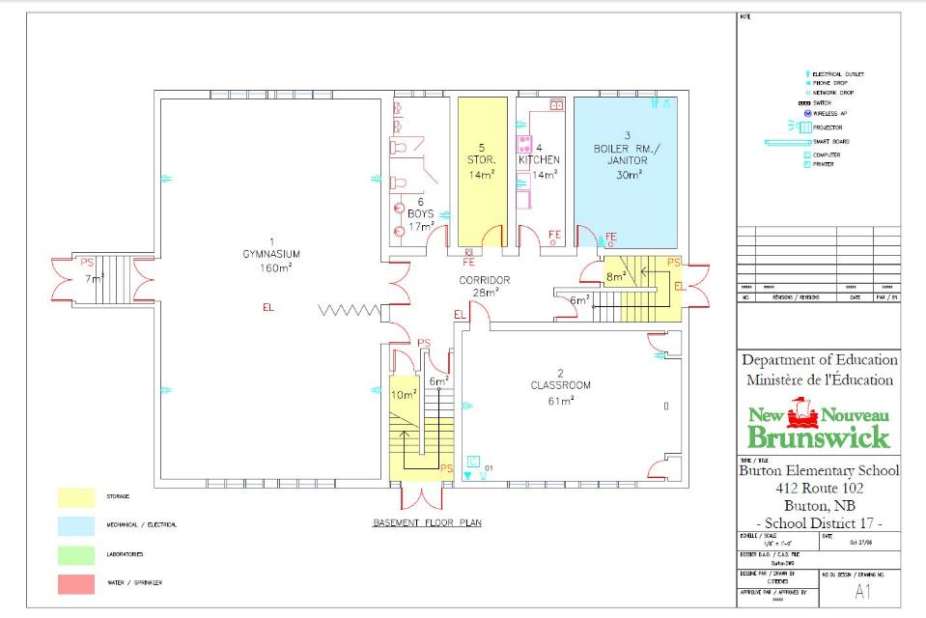

Slide 24
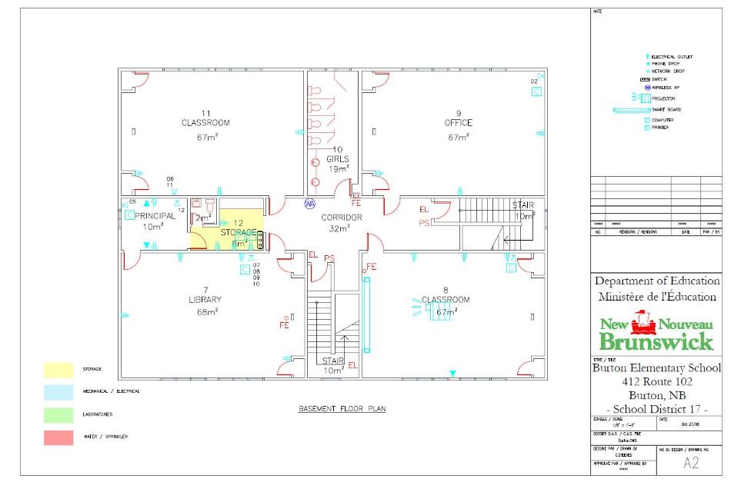

Slide 25
Burton Elementary School Building Systems
Well water supplies the school and is protected by a ultraviolet light. The school has a new sewage system.
The school is heated with an oil fired boiler, with controls. The school has thermostats in the rooms for management of individual temperatures.
The building has exhaust fans as ventilation.
The electrical service is 400 amp, 240 volt panel.

Slide 26
Burton Elementary School Interior
The classrooms and hallways are vinyl tile. The gym floor is a linoleum.
Washrooms have upgraded urinals, sinks and toilets. Floors are ceramic tile in the washrooms.
Stairways are enclosed to meet fire separation requirements complete with fire rated doors.
The school has a fire alarm system and fire extinguishers are located throughout the school.

Slide 27
Burton Elementary School Exterior
Exterior windows and doors have been replaced in previous renovations and are in good condition.
The exterior siding is in poor condition and is to be considered for replacement.
Parking is adequate; pavement has been patched
Exterior lighting is H.I.D. (high intensity discharge).

Slide 28
Burton Elementary School Property
Staff and visitors share the school parking.
The bus zone is located at the front of the school.
Playground has a baseball/soccer field, swings and play structures.

Slide 29
Burton Elementary School Capital Investments
Year | Scope of Work | Cost
2010 | Interior Walls | $10,557
2010/2011 | Sewage System | $11,530
2012 | Heating System | $17,185
2012 | Sewage System | $93,088

Slide 30
Burton Elementary School Physical Plant Status
Building Exterior and Interior |  | Description | Estimated Cost
Building Envelope | Siding | Siding replacement (Priority 1)
Interior Accessibility | Site Additions | Elevator and accessibility (Priority 2)
Heating and Ventilation | Site Additions | Ventilation system (Priority 2)

Slide 31
Burton Elementary School Physical Plant Status (continued)
Building Exterior and Interior |  | Description | Estimated Cost
Interior finishes | Ceiling and Lighting | Upgrade old ceiling and lighting (Priority 3)
Electrical | System Upgrade | Power distribution, panels and receptacles upgrade (Priority 2)
Site Improvement | Paving | Curbing and driveway refinishing (Priority 3)
 |  | Total: | $573,000

Slide 32
Burton Elementary School Transportation Study
Currently students in grades 3-12 that reside in the Burton Elementary School Catchment area are bused to Oromocto schools.
The morning school bus system currently sees one bus transport students within the Burton School Catchment area into the Burton School.

Slide 33
Burton Elementary School Transportation Study
The afternoon school bus system currently sees one bus transport students residing within the Burton School Catchment from the Burton Elementary School.
There would not be any impact with regards to the number of school buses or drivers if the Burton Elementary School should close. There would be a reduction in kilometers travelled by the school buses.

Slide 34
Burton Elementary School Transportation Study
School | Longest Ride In | Longest Ride Out | Earliest Pick-up | Latest Drop Off | Average Ride Time
Burton Elementary School | 55 mins | 55 mins | 7:40 a.m. | 3:09 p.m. | 29 mins

Slide 35
Current Student Address Distances
 | Distance to Burton Elementary School (KM) | Distance to Assiniboine Avenue School (KM) (Scenario)
Average Distance | 2.1 | 11.3 (Average travel time 25 minutes)
Maximum Distance | 5.7 | 16.9 (Maximum travel time 40 minutes)
Minimum Distance | 0.2 | 6.6 (Minimum travel time 10 minutes)

Slide 36
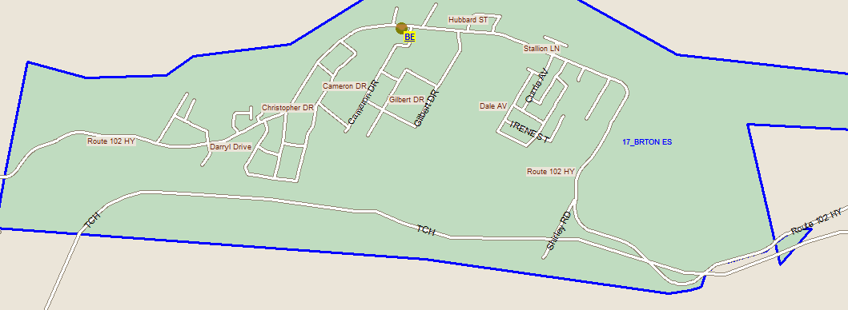
Bus Transportation Study

Slide 37
Salaries
 | Actual Costs
Cost Centers | Fiscal Year | Fiscal Year | Fiscal Year
 | 2014-2015 | 2013-2014 | 2012-2013
Salaries
Administration | 12,504 | 12,315 | 12,252
Teacher | 324,244 | 274,889 | 259,770
Admin. Assistant | 30,568 | 24,517 | 16,185
Educational Assistant | 57,573 | 45,412 | 35,458
Total | 424,889 | 357,133 | 323,665

Slide 38
Assigned Budgets
 | Actual Costs
Cost Centers | Fiscal Year | Fiscal Year | Fiscal Year
 | 2014-2015 | 2013-2014 | 2012-2013
Assigned Budgets
Regular Instruction | 6,345 | 6,471 | 7,063
Admin.Support | 1,566 | 1,597 | 1,546
Library | - | - | -
Teachers Working Conditions | 1,565 | 1,610 | 1,571
Tutor Support | - | - | -
Nutrition | 446 | 495 | 1,236
Bilingual Learning Environ. | - | 250 | 250
Wellness Grant | 1,188 | 450 | 446
Co/Extra Trips | 330 | 336 | 325
PSSC | 145 | 158 | 244
Total | 11,585 | 11,367 | 12,681

Slide 39
Facilities Costs
 | Actual Costs
Cost Centers | Fiscal Year | Fiscal Year | Fiscal Year
 | 2014-2015 | 2013-2014 | 2012-2013
Facilities Costs
Contracted Cleaning | 16,679 | 17,087 | 16,752
Electricity | 4,502 | 4,431 | 3,961
Garbage Removal | 324 | 342 | 342
Ground Maintenance | 3,317 | 2,400 | 2,400
Heating Fuel | 11,388 | 12,493 | 12,656
Cleaning Supplies | 121 | 239 | 106
Minor Repairs | 3,272 | 2,939 | 1,106
Total | 39,603 | 39,931 | 37,323

Slide 40
Total Costs
 | Actual Costs
Cost Centers | Fiscal Year | Fiscal Year | Fiscal Year
 | 2014-2015 | 2013-2014 | 2012-2013
TOTAL COSTS | 476,077 | 408,431 | 373,669

Slide 41
Economic Development With thanks to the Burton Elementary Parent School Support Committee (PSSC) for providing this information.
* Estimated based on 2011 Statistics Canada Data and on 2010 estimates of Burton and Geary populations from a joint report by the Greater Geary Association Inc. and the Burton Interest Citizens Group
Population of Burton 4,042 *

Slide 42
Burton Community Employers, Business, and Services
Burton Elementary School (11 employees, plus 1 bus driver);
Burton Lions Club;
Rob’s Autobody;
Burton Courthouse: Service New Brunswick (6 employees); Crown Prosecutors Regional Office (2 employees); Court Services (3 employees);
Burton Ultramar (approximately 10 employees);
Gilbert Farm Ltd.
5th Canadian Division Support Base (5 CDSB) Gagetown
Pine Grove United Church & cemetery
Several home-based businesses including child care, hair dressing, yoga/fitness services, local produce growers; and homemade products and crafts.
Emergency Services are provided to Burton by the Town of Oromocto (Oromocto Hospital & ambulance services, Oromocto Fire Department) and security by the Royal Canadian Mounted Police.

Slide 43
Burton Elementary students apple picking at Gilbert Farm Ltd., October 7, 2015

Slide 44
Impact on the Community of Burton
Community currently enjoys a small school educational setting for the students in Kindergarten to Grade 2.
Close community ties between the school and local service groups such as the Burton Lion’s Club.
Slight loss in employment opportunities within the school system within the community of Burton; tenured district employees would be placed elsewhere.
Future of vacant building would be unknown and could have a positive or negative impact on the community.
Public meeting # 2 will explore this impact further, as experts and stakeholders from the community share their thoughts .

Slide 45
Burton Elementary School Sustainability Study – Visit our Website for Details!
Sustainability Study Timeline
Minister Letters
Parent Letters
Burton Elementary School at a Glance
Link to Policy 409
Public Meeting #1 – Presentation
www.asd-w.nbed.nb.ca
Feedback can be given
via email at asdwsustainability@nbed.nb.ca
through our discussion board at the Burton Elementary School Sustainability Study site on our webpage
mail to Carol Clark-Caterini, Anglophone West School District, 1135 Prospect Street, Fredericton, NB E3B-3B9
Notes:
Reminder of what “sustainability” means:
Maintain the status-quo
Invest dollars into the infrastructure/programming
Close the school and move the students to another school for their continued education

Slide 46
Questions and Answers

Slide 47
Thank you for coming!

